Slide 1
APT2030 Laser Trip-wire

Slide 2
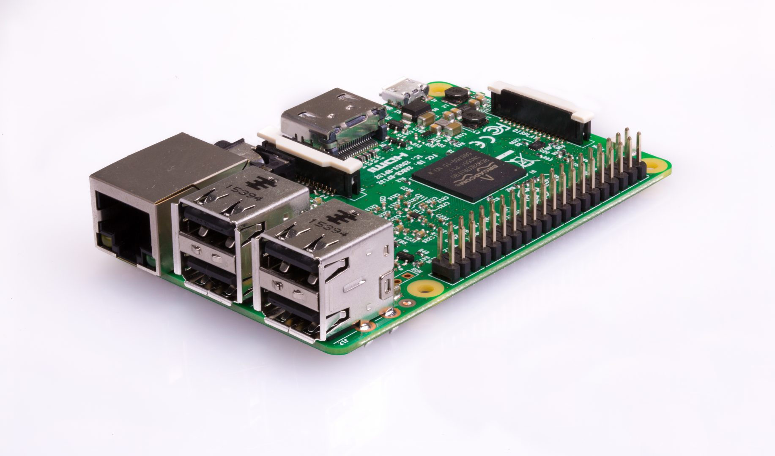
GROUP 2
Dickson John
Catherine Ngugi
Sylvia Macharia

Slide 3
Introduction
In this project we used a laser pointer, a few electronic components, and a Raspberry Pi to make a laser tripwire.
Each time a stealthy intruder breaks the laser beam, the Raspberry Pi will sound an alarm via a buzzer accompanied with a flashing LED.

Slide 4
By completing this project, we learnt how to:
Use a Raspberry pi interface
Connect a circuit to the Raspberry pi using GPIO pins
Measure light levels with an LDR
Control a buzzer/LED

Slide 5


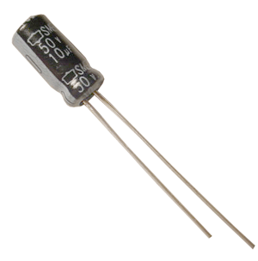
Components used
Hardware
A Raspberry Pi
A breadboard
A 10µF capacitor
A light-dependent resistor (LDR)
Jumper leads
A laser pointer
Software
All required software is pre-installed on Raspbian

Slide 6
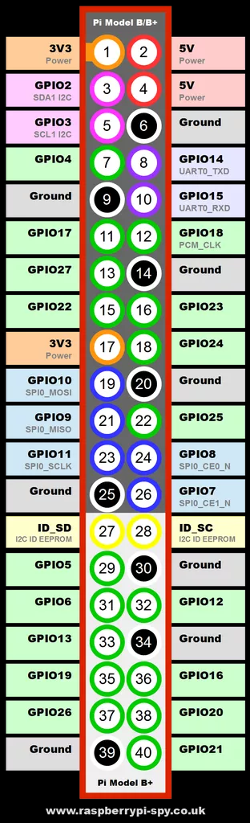
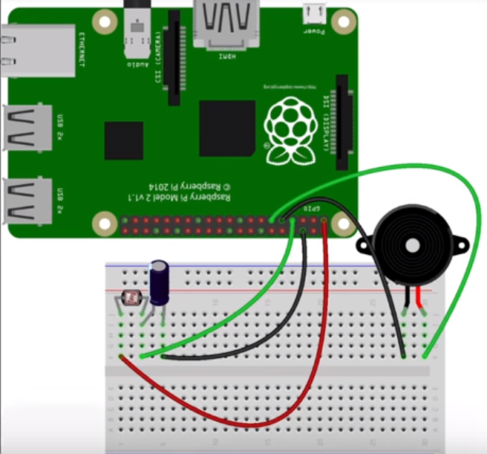
Setup

Slide 7
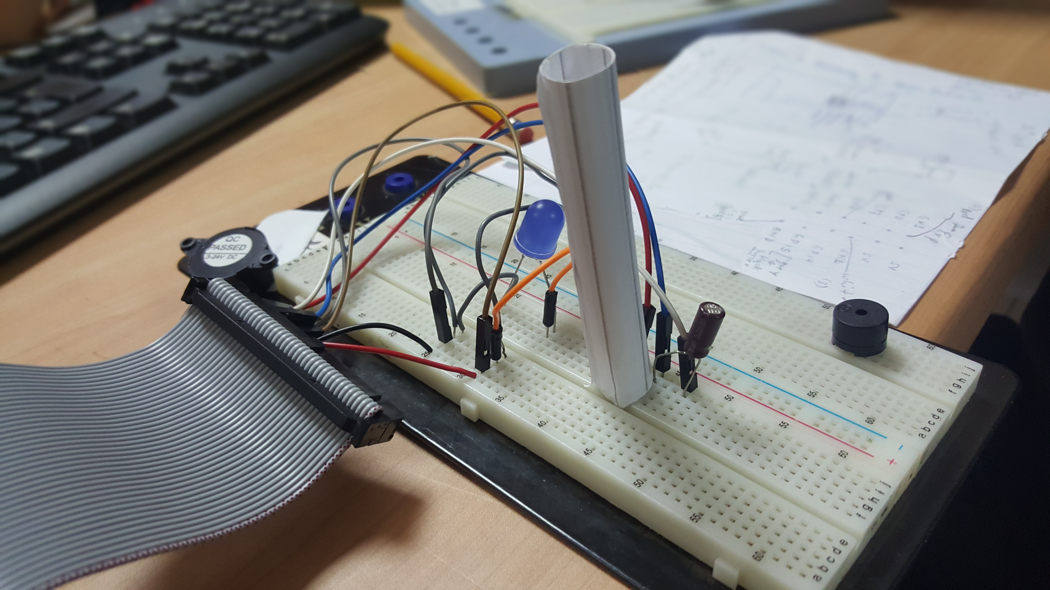
Detecting a broken beam
Shielding the LDR
We shielded the LDR to make sure that only light from the laser pointer will trigger the program. We used a small roll of paper to do this.

Slide 8
Building and coding your light sensor
The circuit was setup using a capacitor and an LDR wired in series to the Raspberry Pi.
GPIO pins cannot measure resistance therefore the time taken for the capacitor to charge is used to calculate the resistance of the resistor.

Slide 9
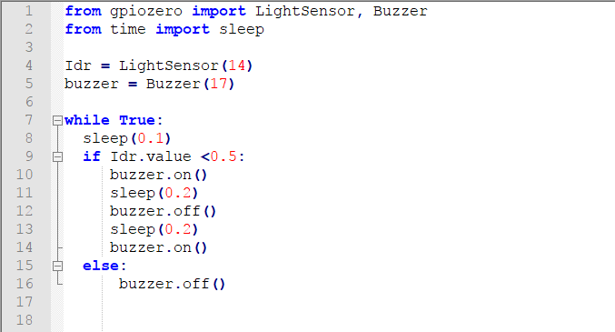
Code

Slide 10
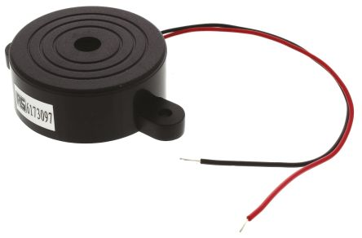
Making some noise
Piezoelectric Buzzer is switched on when the laser beam is broken.
A piezoelectric buzzer works by causing tiny and rapid vibrations of a ceramic disc when a voltage is applied to it. These vibrations in turn produce sound of a single frequency.

Slide 11
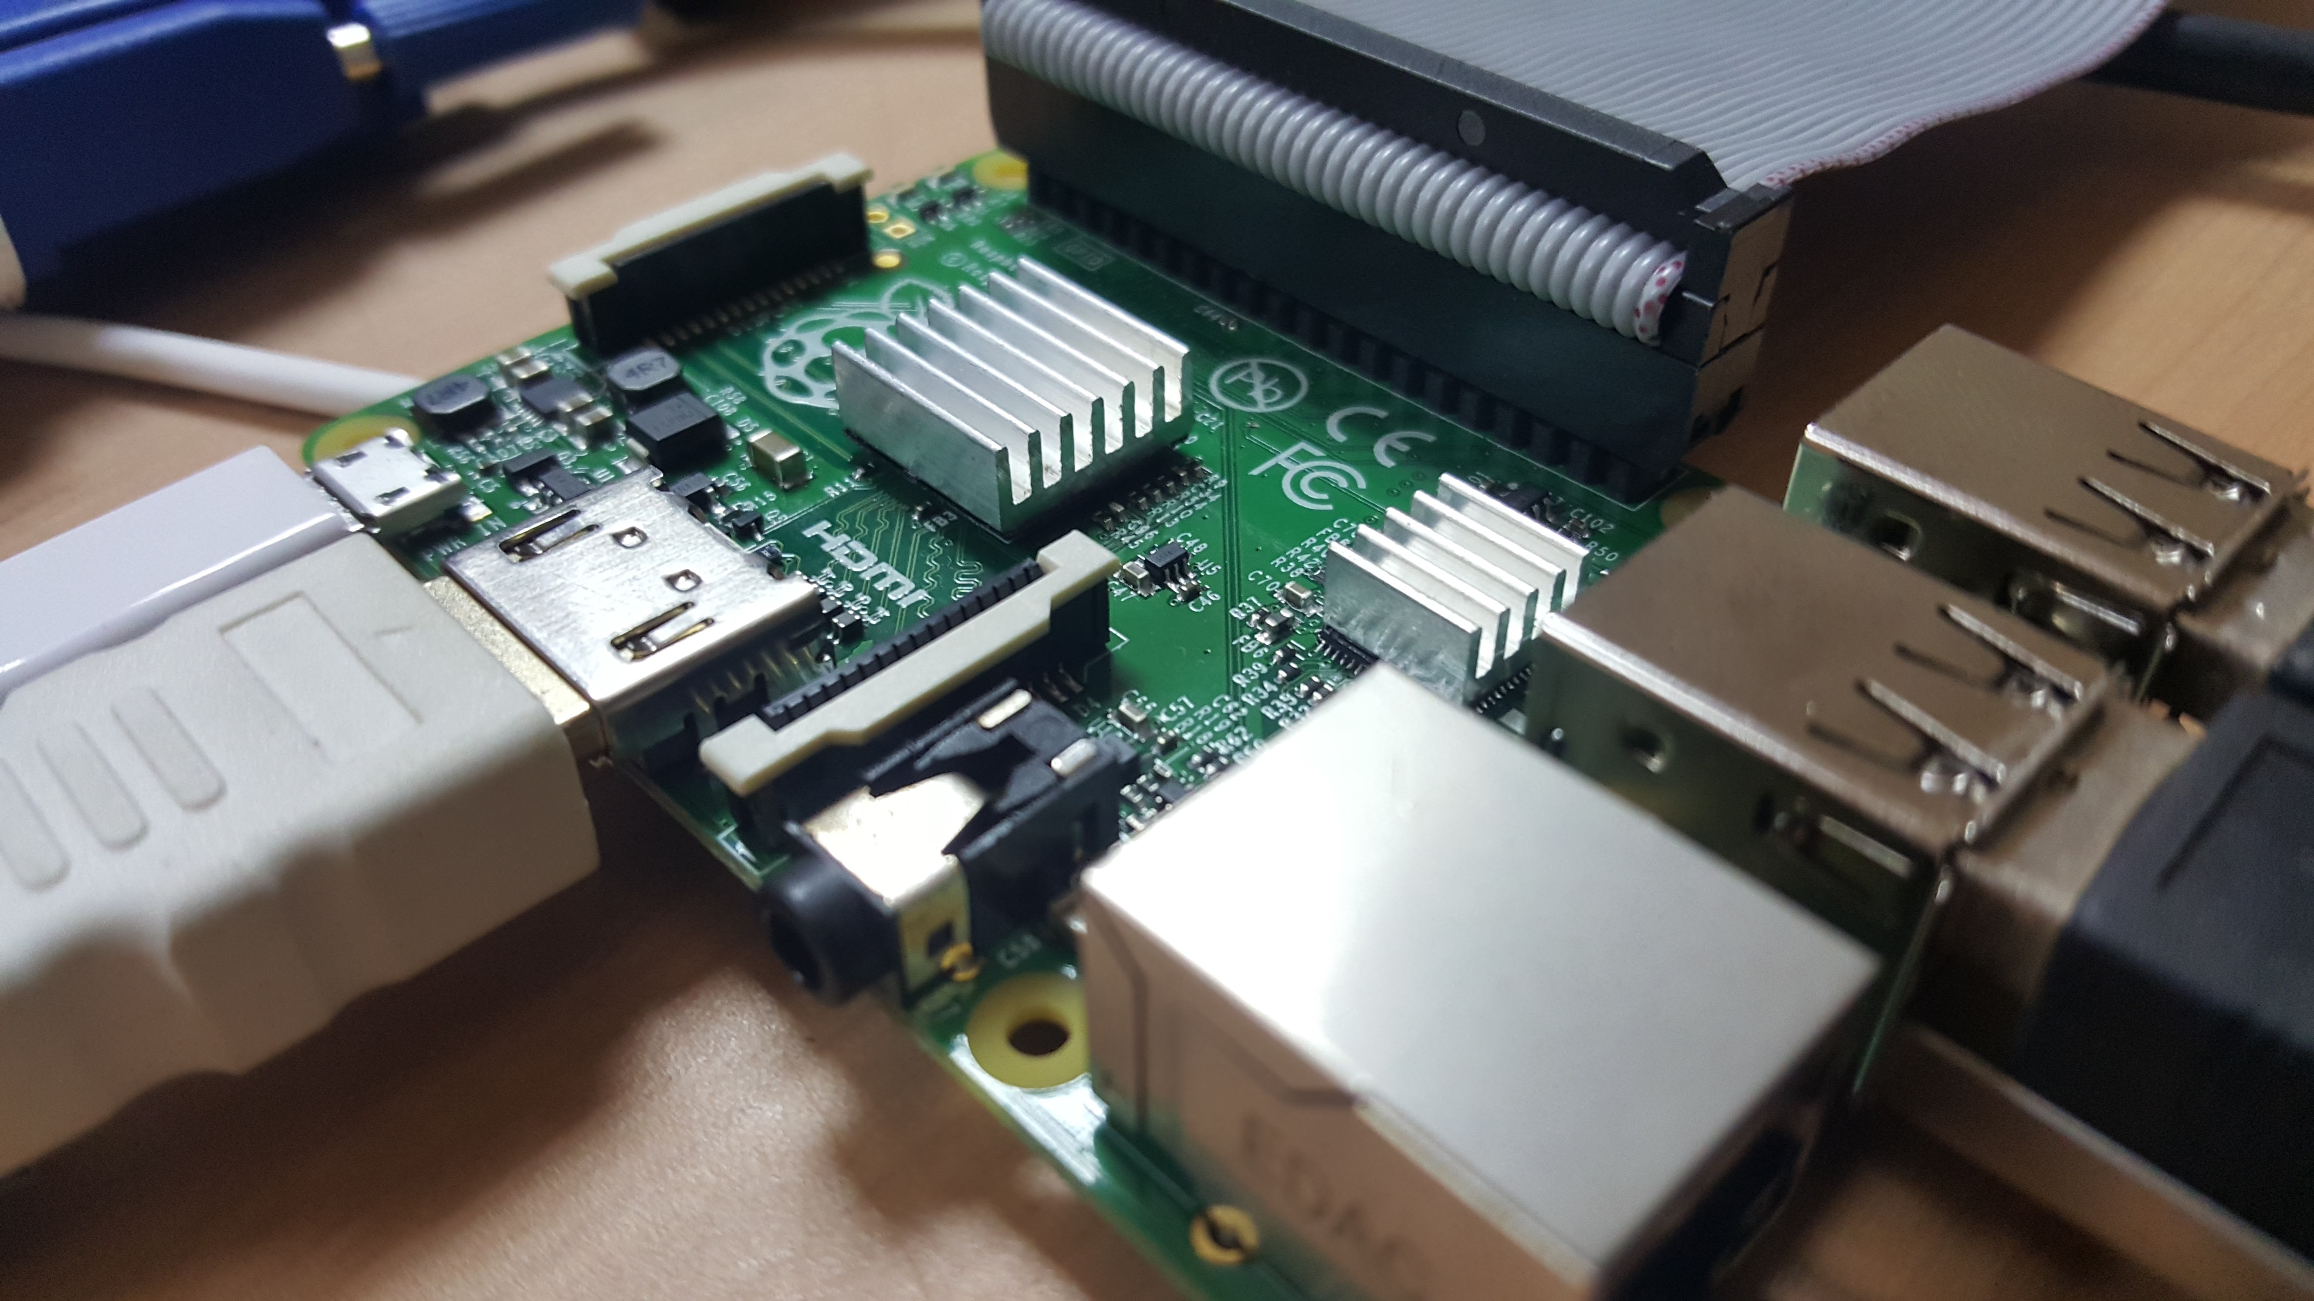
Demo

Slide 12
THANKS!
Any questions?

